Slide 1
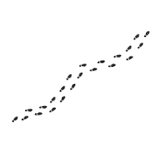
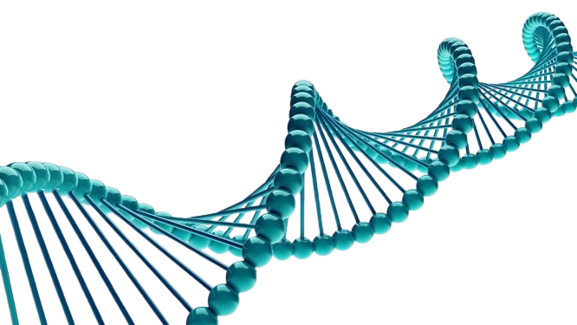
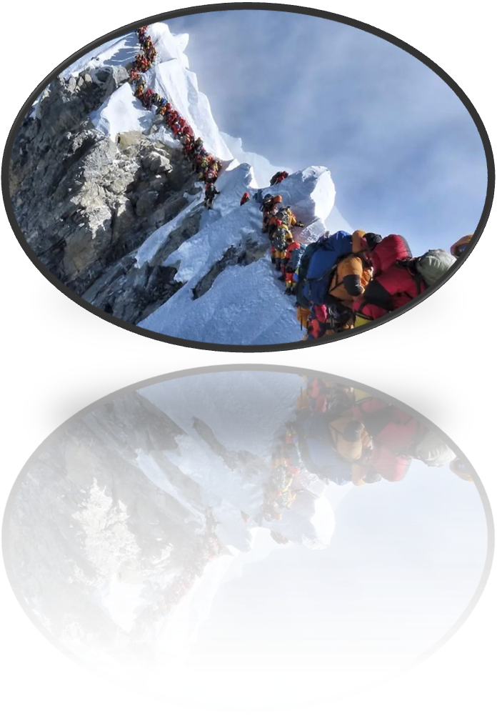
THROWBACK TRACKS
Investigating the contributions of archaic introgression in elite climbers
Eugenia Ampofo

Slide 2
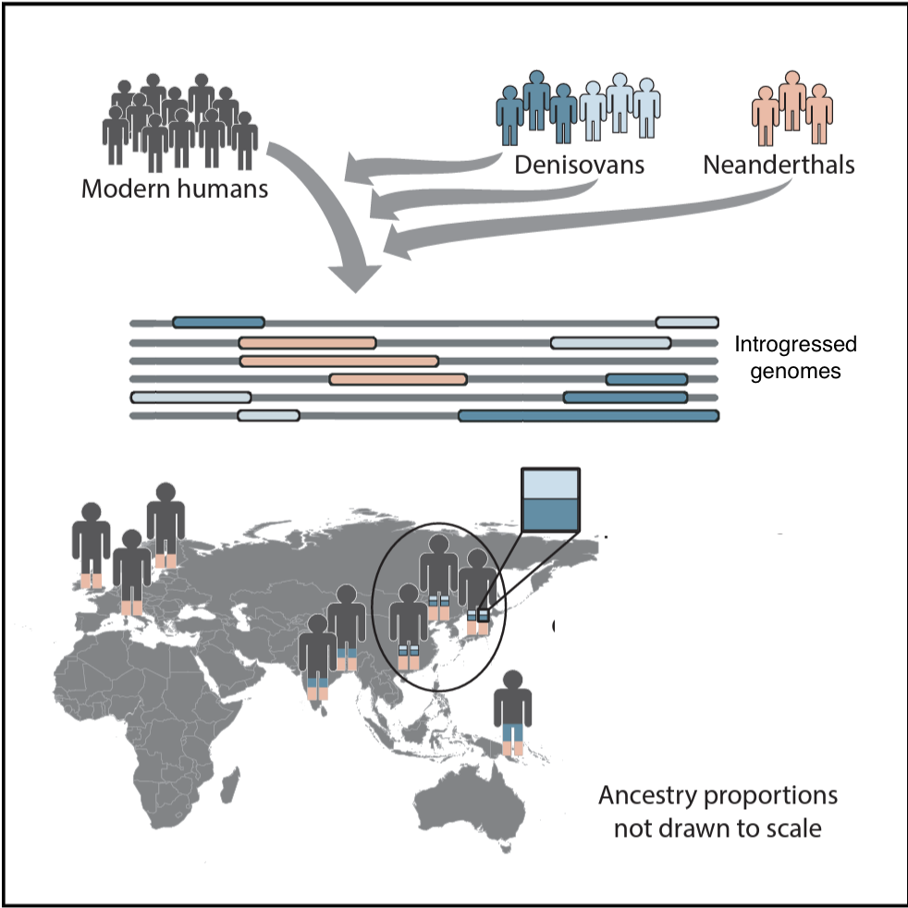
Background: Archaic Introgression
Modern humans have interbred with archaic populations like Denisovans and Neanderthals.
This has led to a flow of genetic material from the archaic populations into the gene pool of Modern humans) known as archaic introgression.

Slide 3
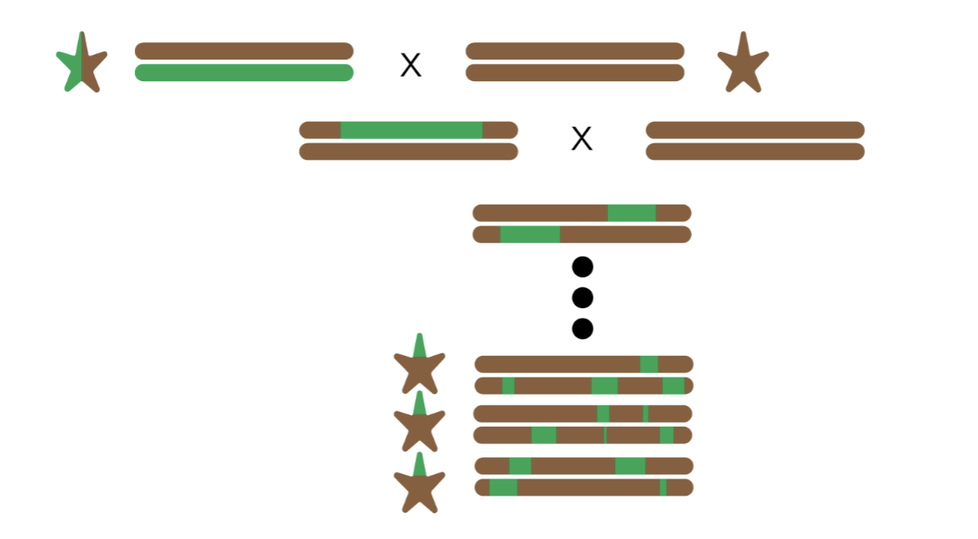
Introduction and objective
Goal of project: To find whether the genes responsible for hypoxia resistance and other climbing advantages in Elite Climbers have origins in archaic introgression.
Notes:
Include images and make use of them during the presentation (talk about the samples about the population

Slide 4
Methodology

Slide 5
Hmixx
The approach is based on a HMM that identifies genomic regions with a high density of SNPs not seen in unadmixed populations without use of reference genome.
Used to detect archaic introgression in Papuans and show how the likely origin(Neanderthal or Denisovan) identified segments can be assigned to.

Slide 6
Definition:
Inputs
Outputs
Ingroup
Autosomal Variant Call Format Files of ingroup(Elite Climbers)
Sample names (10)
Outgroup
Autosomal Variant Call Format Files of outgroup(Yoruba samples)
Sample names
File with callability
the parts of the genome that we can accurately map to
Variant call format files of donor/admixing population(Neanderthal and Denisovan)
Text files for each ingroup sample which shows the segments of genome labeled ”human” and ”archaic

Slide 7
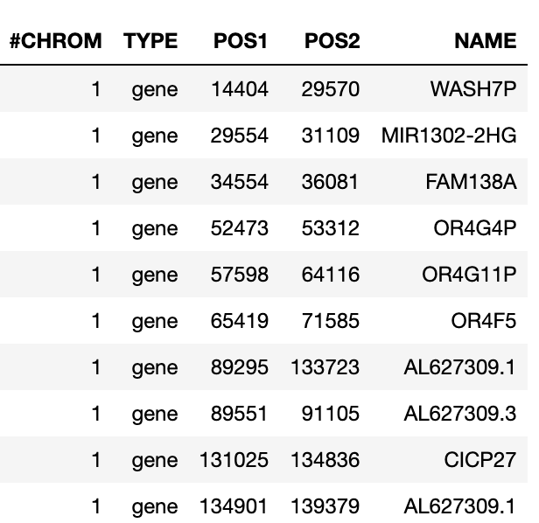

Other materials: Genes associated with hypoxia resistance
Investigation and record of genes which are associated with hypoxia-resistance
Recorded over 56600 genes
Notes:
Talk about the literature no need to have the citations on ther

Slide 8
Steps
Find derived variants in outgroup
Estimate local mutation rate
Find variants in ingroup
Train the HMM
Decoding
Annotate

Slide 9
Baum Welsh algorithm
Given: Observed sequence and initial model.
Goal: Adjust model parameters to maximize the likelihood of the observed sequence.
Initialization
Expectation
Maximization
Check for Convergence
Termination

Slide 10
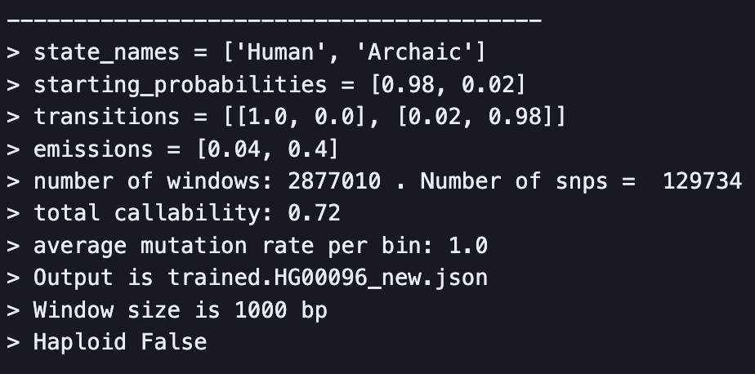
The Algorithm: Baum Welsh
Initialization
Start with initial guesses for the parameters of the HMM: the initial state probabilities (pi), the state transition probabilities (A), and the emission probabilities (B).

Slide 11
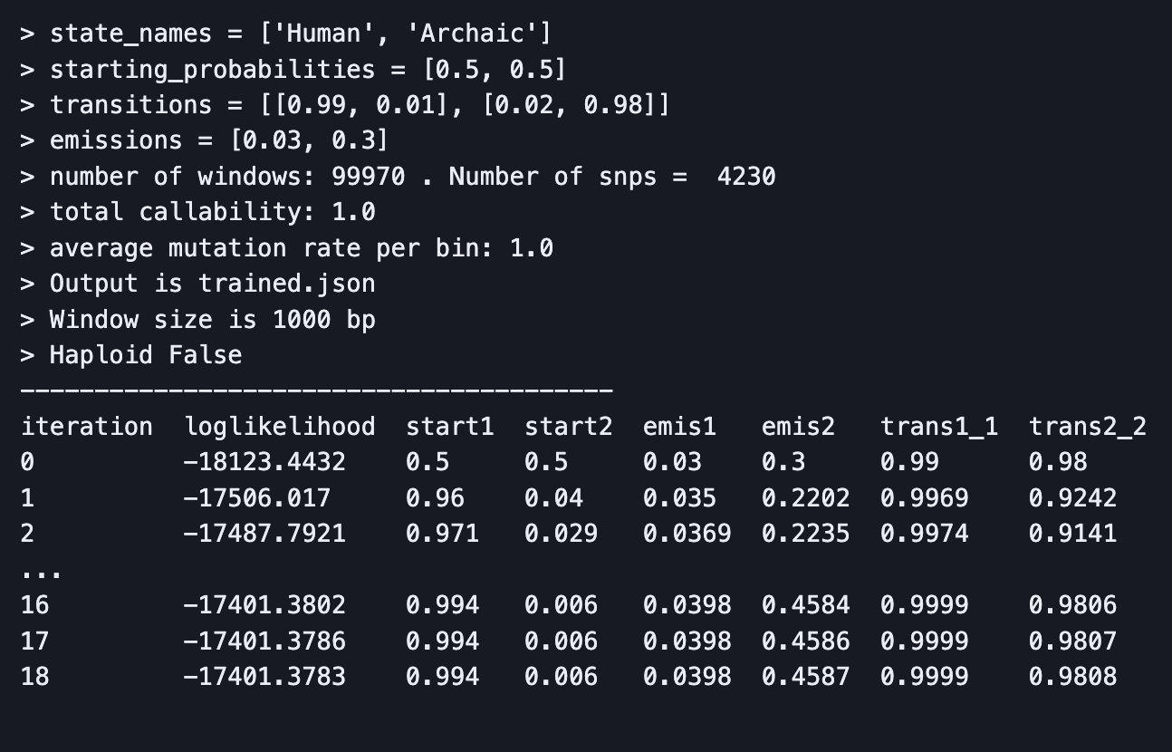
Expectation ( E) Step
Use the forward-backward algorithm to calculate the posterior probabilities for the hidden states given the observed data.

Slide 12
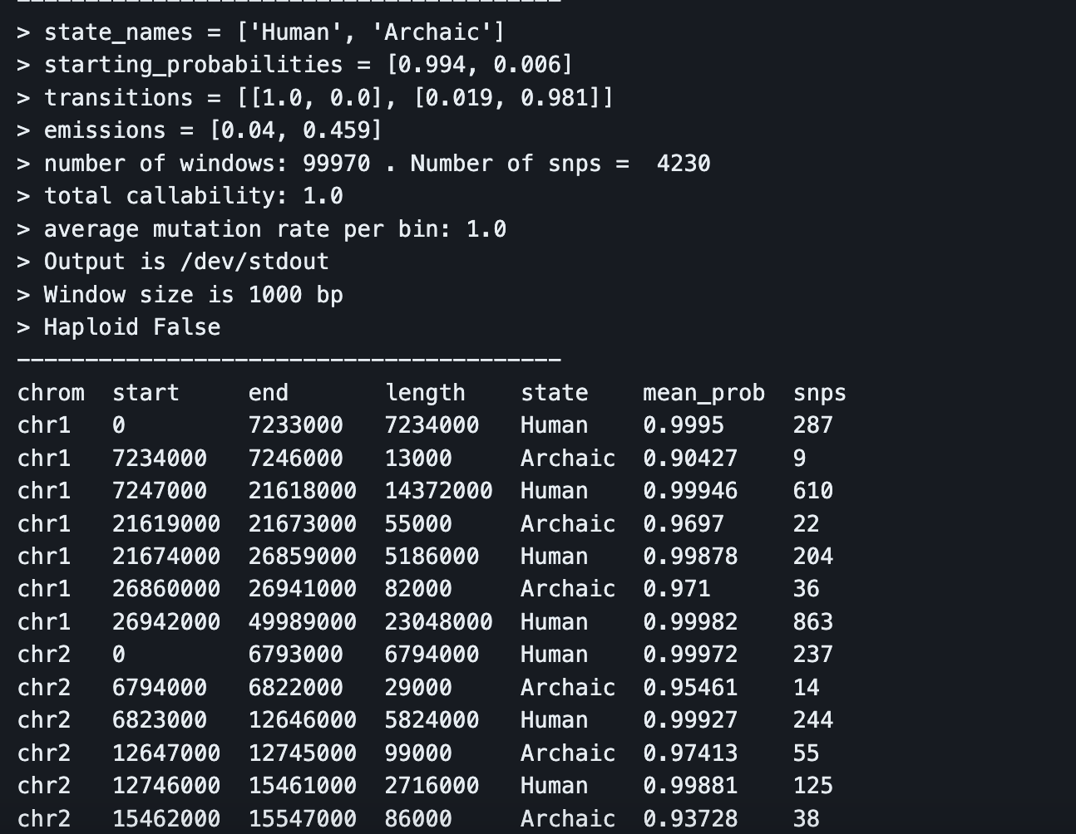
The Algorithm: Baum Welsh
Maximization (M) Step
Convergence
Termination

Slide 13
Steps
Find population segments
Preprocess hypoxia-resistance related gene data
Find matches in mapping
Find proportion of putatively introgressed Neanderthal vs Denisovan
Map alternative allele frequency between climber samples and archaic humans

Slide 14
Results

Slide 15
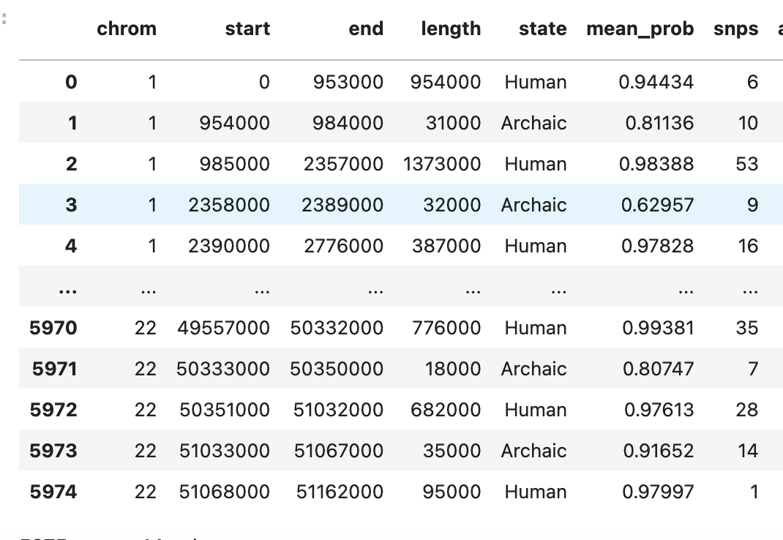
Example of an output file for 1/10 samples

Slide 16
Finding archaic segments that overlap across all samples: Population Segments
Found by going through every chromosome of every samples and finding segments that have overlaps in all 10 samples.
For each chromosome, pick the sample with the most archaic segments
For each segment in that sample, check if that segment overlaps with other segments in each of the other 9
if segment fails to have overlap in one sample, pop/remove from consideration
if segment has overlaps in all 10, save segment and the segments that it overlaps with in the other 10 samples
The ones that directly overlap are then merged into a bigger segment to form the population segment.
the original segments are still kept for further analysis
There were 30 archaic segment overlaps found to have overlaps in all 10 samples
To ensure accuracy, I ran a reverse test to see how many samples the 30 segments have overlap amongst all 10 samples. All 30 have 10
Figures were then made to show distribution of segment lengths of all 30 segments and their corresponding snps(provided by finding their corresponding variants number in the original HMM output)

Slide 17
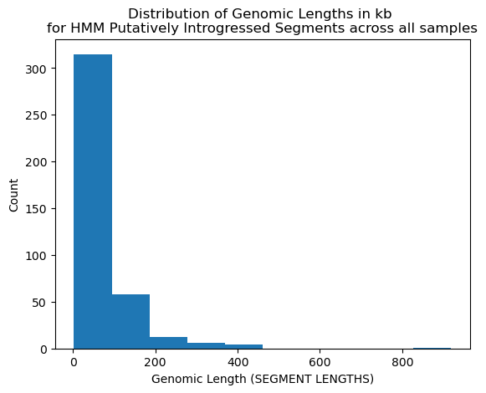
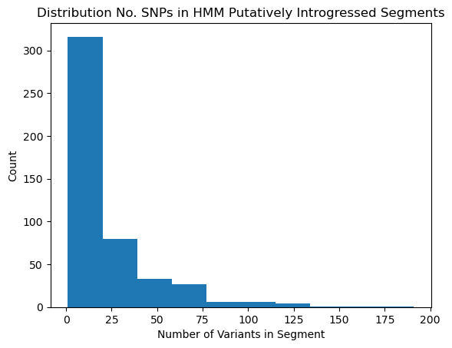
Distribution of population segments found in all samples

Slide 18
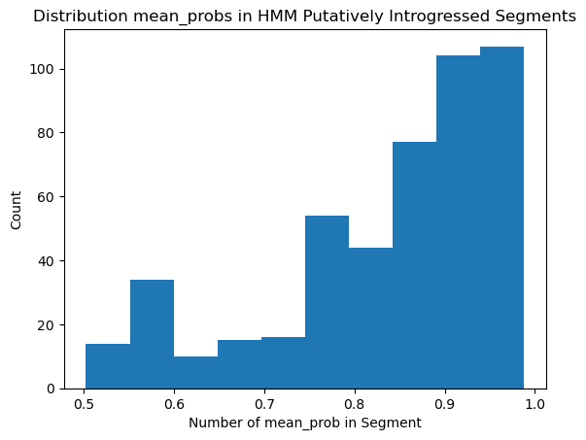

Slide 19
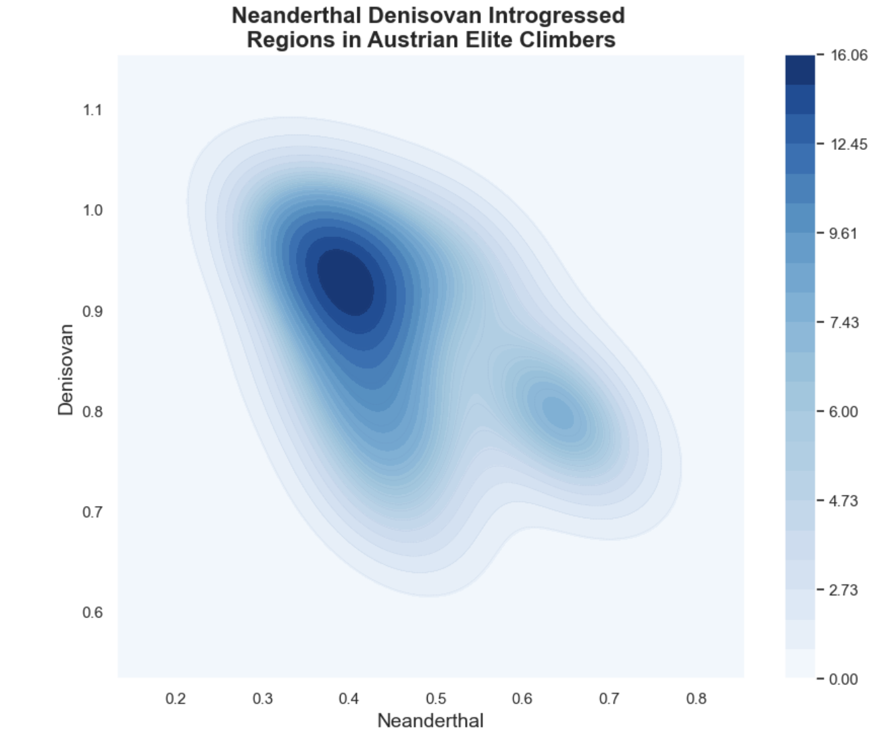
Most segments unique to Austrian Climbers present high affinity to Denisovan Genome

Slide 20
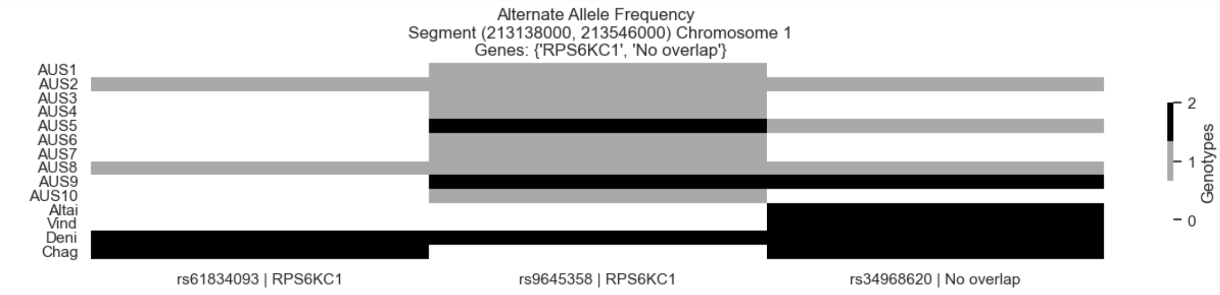
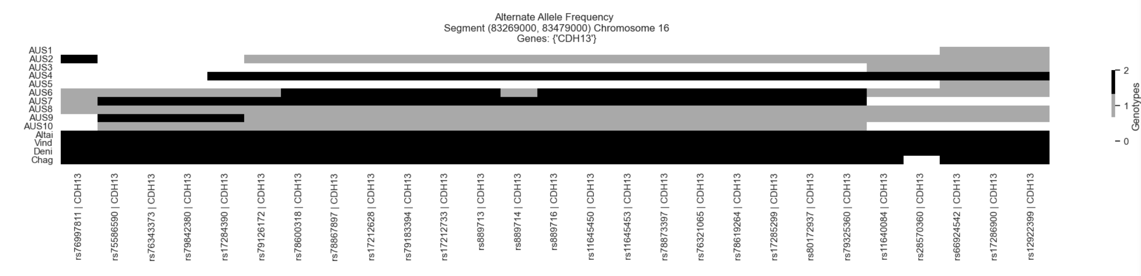

Slide 21
Conclusion and Next Steps
There’s evidence of some hypoxia resistance genes having origins in archaic introgression
Genes: 'ZNF385D’, 'RPS6KC1’ and CDH13 show the most evidence and should be investigated more
It is interesting to see higher affinity for Denisovan Genome vs Neanderthal when the climbers are European. This needs to be further investigated.
Need to take more genes/genetic material into consideration
Some areas of interest do not show overlap perhaps due to the limited amount of genes considered
Further analysis need to be done to be more certain of results
Using other tools such as Sprime, Patterson’s D etc.
Performing statistical tests

Slide 22
Bibliography
Skov L, Hui R, Shchur V, Hobolth A, Scally A, Schierup MH, et al. (2018) Detecting archaic introgression using an unadmixed outgroup. PLoS Genet 14(9): e1007641. https://doi.org/10.1371/journal.pgen.1007641
Huerta-Sánchez, Emilia, et al. “Altitude Adaptation in Tibetans Caused by Introgression of Denisovan-like DNA.” Nature News, Nature Publishing Group, 2 July 2014, www.nature.com/articles/nature13408
Ze-Xian Liu, Panqin Wang, Qingfeng Zhang, Shihua Li, Yuxin Zhang, Yutong Guo, Chongchong Jia, Tian Shao, Lin Li, Han Cheng, Zhenlong Wang, iHypoxia: An Integrative Database of Protein Expression Dynamics in Response to Hypoxia in Animals,Genomics, Proteomics & Bioinformatics, 2022, https://doi.org/10.1016/j.gpb.2022.12.001

